Slide 1
Blockchain versus Database: A Critical Analysis
CSE449: Parallel, Distributed, and High-Performance Computing (HPC)
Team 3
Rajvir Ahmed Shuvo 20141003
Ehsanur Rahman Rhythm 22241163

Slide 2
The main question they address with this paper is, whether or not the proposed applications of the blockchain technology as a solution to problems, have a well-founded basis.
The underlying technology that enables Bitcoin (or more generally crypto-currency) is called blockchain.
Its records are immutable, making it unique. Consensus and cryptography ensure immutability.
Usage of Blockchains:
Healthcare
Government
Business
Higher Education Institutions
Internet of Things (IoT)

Slide 3
In this paper, they have ..
Examined blockchain research trends over the past five years.
Compared blockchain and database technologies.
Propose a decision tree to determine if the use case should use blockchain. If so, which blockchain technology?
Used the decision tree to assess the literature to see if blockchain's unique advantages justify its proposed uses.

Slide 4
BLOCKCHAIN
Blockchain technology's core is the blockchain. Blockchains are ledgers with consecutive blocks chained together. A consensus algorithm creates each block of the ledger at a predefined interval on P2P network nodes, which distribute and store it. Blockchain's consensus algorithm ensures data integrity.
Blockchains are suitable for many applications due to their following properties:
Distributed consensus on the chain state
Immutability and irreversibility of chain state
Data (transaction) persistence
Data provenance
Distributed data control
Accountability and transparency
Blockchain is the technology behind Bitcoin and other crypto-currencies.
Notes:
Blockchain has garnered attention from industry, government, and academia in recent years as a key technology that will transform several application domains. Blockchain technology's core is the blockchain. Blockchains are ledgers with consecutive blocks chained together. A consensus algorithm creates each block of the ledger at a predefined interval on P2P network nodes, which distribute and store it. Blockchain's consensus algorithm ensures data integrity. Now we discuss about the properties because of which blockchains are suitable for many applications. First one is, Distributed consensus on the chain state. That is, Any blockchain must be able to reach a distributed consensus without a trusted third party. This allows authorized entities to build and use a system that verifies every state or interaction. Then, we find, Immutability and irreversibility of chain state. After a while, a distributed consensus with many nodes makes the chain state immutable and irreversible. Smart-contracts enable immutable computer program deployment and execution. Then Data Persistence means, Blockchain data is distributed and persists as long as the P2P network has nodes. In the next point, Data provenance, it explains about the transaction. The data storage process in any blockchain is facilitated by means of a mechanism called the transaction. Public key cryptography must sign every transaction to verify data source. Combining this with a blockchain's immutability and irreversibility creates a strong data non-repudiation tool. Moreover, Data in a blockchain is distributed and has no single point of failure. Then for the last property, it explains the accountability and transparency of blockchain because any authorized entity can verify the chain's state and all participant interactions.

Slide 5
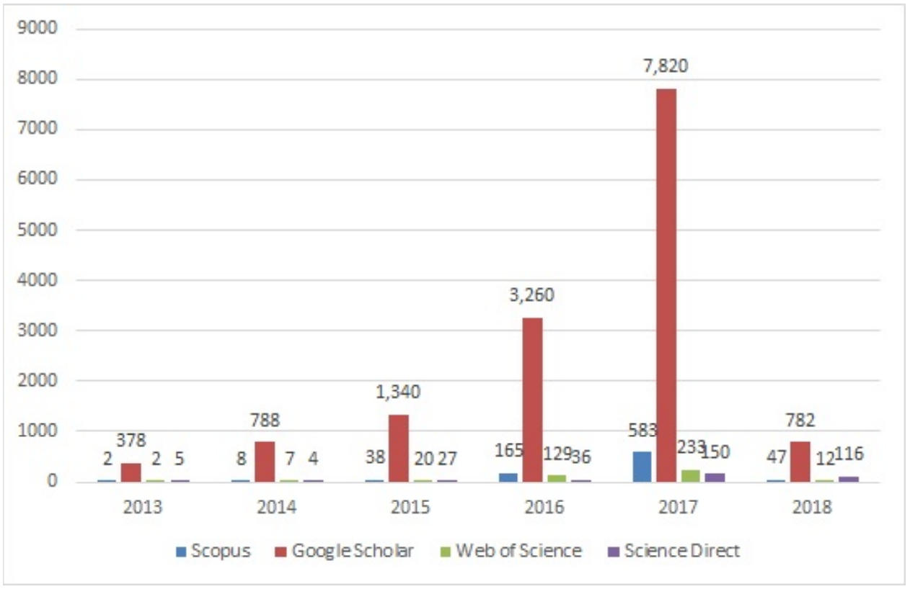
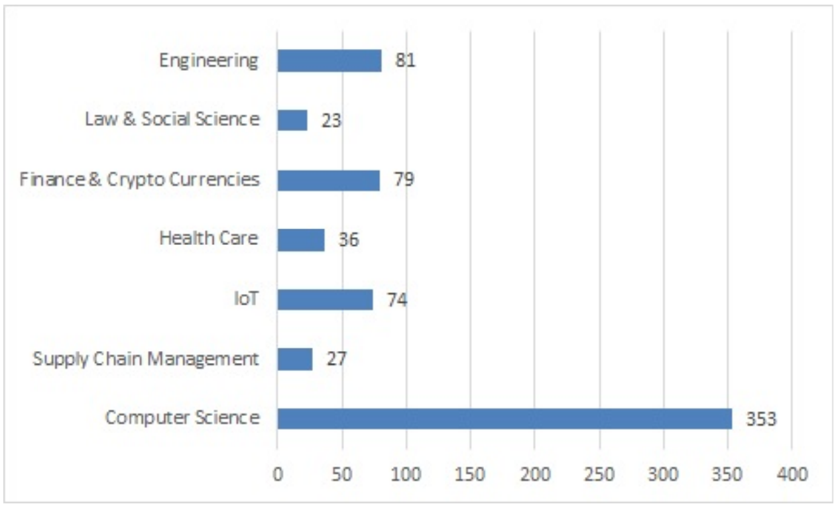
Scoping Review
In the review, they identified blockchain research trends and application domains that have garnered the most attention.
Volume and Trend of Research
Subject Areas
Year-wise number of research publication
Subject area wise research publication

Slide 6
Application Domain Analysis
Supply Chain Management manages material and information flows between vendors, manufacturing and assembly plants, and distribution centers distribution centers. It records all interactions until the product is consumed.
Supply chain management involves multiple parties and lacks trust. Thus, one party keeps its information private.
Many practitioners solve this problem by introducing a trusted third party. A and B trust the trusted third party and reveal their information. It's hard to find a trustworthy third party.
Blockchain can build trust between parties without a trusted third party.
Supply Chain Provenance

Slide 7
Application Domain Analysis
Real-time transactions are available within the same bank in the current banking system. If two banks are involved, it can take 2-3 days. International transactions worsen it. Time and cost are the current setup issues.
Blockchain could speed up interbank payments.
Performance is crucial in banking. Blockchain in its current form cannot handle the volume of banking transactions.
A consortium could create and manage crypto for that network. Thus, the consortium can set that network's crypto price.
Inter Bank Transactions

Slide 8
Application Domain Analysis
In the current health-care system, providers keep patient records but rarely share them. Blockchain in health care reduces doctor administrative time so they can spend more time with patients and sharing data.
Healthcare is extremely sensitive and complex. Legislative requirements slow technology adoption.
Interoperability and collaboration are crucial for service delivery and innovation in this sector. Interoperability and collaboration can be achieved using blockchain without compromising health care provider security.
Blockchain in health without research and usability testing could be disastrous. In a critical moment, blockchain scalability issues may delay doctor access, which could have dire consequences.
Health Care

Slide 9
BLOCKCHAIN VERSUS DATABASE TECHNOLOGY
In-depth analysis by considering different types of consensus mechanisms (in V-D), and attack vectors (e.g., DDos (in V-C), 51% attack (in V-E))
Trust Building
Confidentiality and Privacy
Robustness/Fault Tolerance
Performance
Security

Slide 10
WHEN SHOULD WE USE BLOCKCHAIN?
Blockchain is not a general purpose technology but should be applied judiciously to reap its benefits
Blockchain technology is useful in those cases where there are more than one administrative authority and there is a trust deficit among those parties
Supply chain management system
Consortium of independent companies working on a government project
Decide whether we should use public blockchain or private blockchain

Slide 11
ASSESSMENT OF EXISTING USE OF BLOCKCHAIN
Analyzed a sample of 100 papers among the 800+ papers surveyed from Scopus using the decision tree model
Blockchain has emerged as a productive technology for supply chain management
9 papers out of 25 papers(which used the unique properties of blockchain) are related to supply chain 1352 management system and power grid.
An example of inappropriate use of blockchain can be smart home scenarios
Smart home is a private network and usually does not have any trust issues

Slide 12
CONCLUSION
Blockchain has gained much attention from both researchers and practitioners.
In this paper, through a scoping survey, areas that have received the most attention from the blockchain research community have been identified.
A critical analysis of these domains, regarding their need for blockchain.
A critical analysis of these domains, regarding their need for blockchain.
A decision tree to evaluate the appropriate use of blockchain

